Slide 1
Software Quality Assurance
Maturity Models

Slide 2
Lecture Outline
Basic Idea in Software Process
Capability Maturity Model (CMM) &
Capability Maturity Model Integration (CMMI)
Test Process Improvement (TPI)
Testing Maturity Model (TMM)
Summary

Slide 3
Basic Idea in Software Process
A process comprises a set of activities that are executed to develop products.
  The activities find expressions in the form of methods, techniques, strategies, procedures, and practices.
  The activities heavily rely on information repositories, such as documents, standards, and policies.
Different processes are driven by different goals and availability of resources.

Slide 4
Basic Idea in Software Process
It is useful to follow a defined process because of the following benefits:
  The process can be repeated in subsequent projects
  The process can be evaluated by using a variety of metrics, such as cost, quality, and time to deliver
  Actions can be taken to improve the process to achieve better results

Slide 5
Basic Idea in Software Process
A software process comprises the following tasks –
  Gathering requirements
  Constructing a functional specification
  Designing the system
  Writing code
  Testing the system
  Delivering the system
  Maintaining the system

Slide 6
Basic Idea in Software Process
Software testing is treated as a distinct process because it involves a variety of unique activities, techniques, strategies, and policies.
  Testing is performed to reveal defects and show to what extent the software possesses different quality attributes, such as reliability and performance.
  Testing begins almost at the same time a project is conceptualized.
  Testing is carried out by different people at different stages of system development.
  A number of different techniques can be applied at each level of testing.
  A number of different strategies can be applied at each level of testing.
  A number of metrics can be monitored to gauge the progress of testing.
  Testing is influenced by organizational policies.
  Testing can be performed as a combination of manual and automated modes of execution of test cases.
Notes:
Reveal – প্রকাশ করা
Handouts

Slide 7
Basic Idea in Software Process
To be able to improve a defined process, organizations need to evaluate its capabilities and limitations.
  Example: The Capability Maturity Model (CMM) allows an organization to evaluate its software development processes.
    The CMM model supports incremental process improvement.
A separate model, known as the Testing Maturity Model (TMM), has been developed to evaluate a testing process.
For an organization to be able to improve their testing process, the Test Process Improvement (TPI) model has been developed.
Notes:
Handouts

Slide 8
Capability Maturity Model (CMM)
While awarding a contract, the customer needs to gain confidence that an organization is capable of delivering the desired product.
The US Department of Defense wanted to evaluate their contractors.
  They needed a framework to evaluate the maturity of software processes
  In 1986, the Software Engineering Institute (SEI) initiated the development of a framework to be called the CMM
In the CMM model, the maturity level of an organization tells us to what extent an organization can produce low cost, high quality software.
Having known the current maturity level, an organization can work to reach the next higher level.
  There are five maturity levels in the CMM model
Notes:
Handouts

Slide 9
CMM Levels
There are five(5) levels in CMM:
    Level 1: Initial
    Level 2: Repeatable
    Level 3: Defined
    Level 4: Managed
    Level 5: Optimizing

Slide 10
CMM's Five Maturity Levels of Software Processes
At the Initial level, processes are disorganized, even chaotic. Success is likely to depend on individual efforts, and is not considered to be repeatable, because processes would not be sufficiently defined and documented to allow them to be replicated.
At the Repeatable level, basic project management techniques are established, and successes could be repeated, because the requisite processes would have been made established, defined, and documented.
At the Defined level, an organization has developed its own standard software process through greater attention to documentation, standardization, and integration.
At the Managed level, an organization monitors and controls its own processes through data collection and analysis.
At the Optimizing level, processes are constantly being improved through monitoring feedback from current processes and introducing innovative processes to better serve the organization's particular needs.

Slide 11
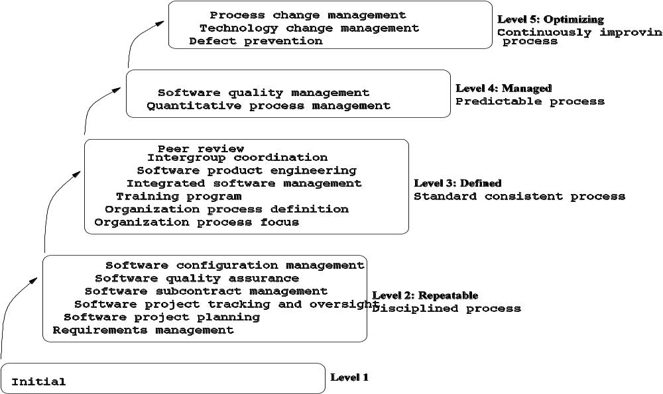
Capability Maturity Model (CMM)
Figure : SW-CMM maturity levels
Notes:
Handouts

Slide 12
Capability Maturity Model (CMM)
Application of the CMM
  For an organization to be at a certain level of maturity, all the goals of all the KPAs at that level – and all preceding levels too – must be satisfied.
    Example: For an organization to be at Level 3, it must meet all the six KPAs at Level 2 and all the seven KPAs at Level 3.
  The SEI developed the Capability Maturity Model-Based Assessment Internal Process Improvement (CBA-IPI) to assist organizations for self-assessment.
    The CBA-IPI uses the CMM as a reference model to evaluate the process capability of organizations by identifying what KPAs are being satisfied and what need to be improved.
  The SEI developed the CMM Appraisal Framework (CAF) to provide a mechanism for formal evaluation of organizations.
    CAF describes the requirements & guidelines to be used by external assessors.
Notes:
Handouts

Slide 13
Test Process Improvement (TPI)
A test process is a certain way of performing activities related to defect detection. A few such activities are as follows:
  Identifying test goals
  Preparing a test plan
  Identifying different kinds of tests
  Hiring test personnel
  Designing test cases
  Procuring test tools
  Assigning test cases to test engineers
  Prioritizing test cases for execution
  Organizing the execution of test cases into multiple test cycles
  Executing test cases
  Reporting defects
Notes:
Handouts

Slide 14
Test Process Improvement (TPI)
A simple test process for system-level testing
  Categorize the features of a system into k groups
  Design N_{i} test cases for feature category i, for 1 ≤ i ≤ k. These N_{i} test cases are denoted by the set T_{i}
  Run T₁ U … U T_{k} to detect defects
  Run T₁ U … U T_{k} each defect fix until no more defects are found, or it is time to release the system
Deficiencies in the above simple process:
  Test tools have not been used
  Test cases have not been prioritized
  The entire test suite has been executed in each test cycle
Therefore, it is important to improve test processes by following a defined model.
  The idea of improving test processes by following a model, namely the Test Process Improvement (TPI) model, was first studied by Tim Koomen and Martin Pol.
Notes:
Handouts

Slide 15
Test Process Improvement (TPI)
Why does a test process need to be improved?
A test process needs to be improved for three reasons:
Quality: A better test process should give more insights into the quality characteristics of a system being tested.
Lead Time: A better test process saves testing time, and thereby gives more time to other areas of system development.
Cost: A better test process is expected to be carried out with a lower cost.
Notes:
Handouts

Slide 16
Test Process Improvement (TPI)
How to improve a test process?
An intuitive approach to improving a test process is as follows:
  Step 1: Determine an area for improvement.
  Step 2: Evaluate the current state of the test process.
  Step 3: Identify the next desired state and the means to achieve it.
  Step 4: Implement the necessary changes to the process.

Slide 17
Test Process Improvement (TPI)
The TPI model supports gradual process improvement.
  The current status of a test process is evaluated from different viewpoints, known as key areas – and 20 key areas have been identified
  The status of a test process w.r.t. a key area is represented in terms of one of four levels of maturity – A, B, C, and D

Slide 18
Test Process Improvement (TPI)
The 20 key areas are as follows:
  Test strategy
  Life-cycle model
  Moment of involvement
  Planning and estimating
  Test specification technique
  Static test technique
  Metrics
  Test tools
  Test environment
  Office environment
  Test process management
  Evaluation
  Low-level testing
  Commitment and motivation
  Test functions and training
  Scope of methodology
  Communication
  Reporting
  Defect management
Notes:
Handouts

Slide 19
Test Process Improvement (TPI)
Maturity levels of test processes:
  Based on the idea of dependencies and prioritization, a Test Maturity Matrix is constructed.
  Test Maturity Matrix shows that the overall maturity of a test process can be represented on a scale of 1—13.
  The 13 scales of maturity of a test process are classified into three distinct segments as follows:
    Controlled (1—5): All component activities are planned and executed in phases according to the plan.
    Efficient (6—10): All the key areas, except Evaluation, are raised to at least B level with some being at C.
    Optimizing (11—13): All the key areas have reached their respective highest maturity levels.
      ==> Optimizing a test process means performing testing tasks in the best possible manner from the standpoint of quality, time, and cost.
Notes:
Handouts

Slide 20
Test Process Improvement (TPI)
Applying the TPI model:
  Analyze the current test process, in terms of the 20 key areas, and give each key area a rating – A, B, C, or D.
  Evaluate the current scale, between 1—13, of the test process by comparing the current status of the test process with the standard Test Maturity Matrix
  Identify the goal of the organization in terms of the next scale to be achieved. Identify the key areas where improvements must be achieved.
  Take actions to improve the key areas identified in the preceding step.
Notes:
Handouts

Slide 21
Testing Maturity Model (TMM)
Similar to the concept of evaluating and improving software development processes, there is a need for a framework to asssess and improve testing processes.
Continuous improvement of testing processes is an ideal goal of organizations.
Evaluation plays a key role in process improvement.
TMM was pioneered by Ilene Burnstein to help organizations evaluate and improve their testing processes.
Notes:
Handouts

Slide 22
Testing Maturity Model (TMM)
The TMM framework describes an evolutionary path of test process maturity in five levels/stages.
Each level is characterized by the concepts of
  Maturity goals
  Supporting maturity goals, and
  Activities, Tasks, and Responsibilities (ATRs)

Slide 23
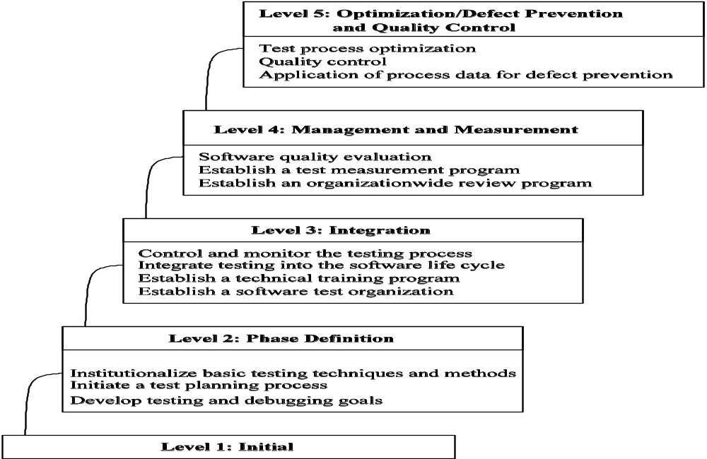
Testing Maturity Model (TMM)
Figure : The 5-level structure of the TMM
Notes:
Handouts

Slide 24
Testing Maturity Model (TMM)
Maturity goals
  Each maturity level, except 1, contains certain maturity goals
  For an organization to reach a certain level, the corresponding maturity goals must be met by the organization
Maturity sub-goals
  Maturity goals are supported by maturity sub-goals
ATRs
  Maturity sub-goals are achieved by means of ATRs
  ATRs are further refined into “views” from the perspectives of three groups:
    Managers
    Developers and test engineers
    Customers (user/client)
Notes:
Handouts

Slide 25
TMM Levels
Initial
Phase definition
Integration
Management and Measurement
Optimization/Defect Prevention and Quality Control

Slide 26
Testing Maturity Model (TMM)
Level 1 – Initial
  There are no maturity goals to be met at this level.
  Testing begins after code is written.
  An organization performs testing to demonstrate that the system works.
  No serious effort is made to track the progress of testing.
  Test cases are designed and executed in an ad hoc manner.
  In summary, testing is not viewed as a critical, distinct phase in software development.
Notes:
Handouts

Slide 27
Testing Maturity Model (TMM)
Level 2 – Phase Definition: The maturity goals are as follows:
  Develop testing and debugging goals
  Initiate a test planning process:
    Identify test objectives
    Analyze risks
    Devise strategies
    Develop test specifications
    Allocate resources
  Institutionalize basic testing techniques and methods
Notes:
Handouts

Slide 28
Testing Maturity Model (TMM)
Level 3 – Integration: The maturity goals are as follows:
  Establish a software test group.
  Establish a technical training program.
  Integrate testing into the software lifecycle.
  Control and monitor the testing process.
Notes:
Handouts

Slide 29
Testing Maturity Model (TMM)
Level 4 – Management and Measurement: The maturity goals are:
  Establish an organization-wide review program.
  Establish a test management program.
  Evaluate software quality.
Notes:
Handouts

Slide 30
Testing Maturity Model (TMM)
Level 5 –Optimization/Defect Prevention and Quality Control: The maturity goals are as follows:
  Application of process data for defect prevention
  Statistical quality control
  Test process optimization
Notes:
Handouts

Slide 31
Summary
Capability Maturity Model (CMM)
  The CMM is a framework for evaluating and improving the present capability of a software development company.
  The CMM is used to assess & improve the maturity level of an organization to develop software products.
  Five levels of maturity
    Level 1: Initial
    Level 2: Repeatable
    Level 3: Defined
    Level 4: Managed
    Level 5: Optimizing
  Each level is characterized by a set of key process areas(KPA).

Slide 32
The CMMI
CMMI is a model for judging the maturity of software
processes of an organization & for identifying the key practices that are required to increase the maturity of these processes.
Five maturity levels of CMMI:
  Level 1 : Initial
  Level 2 : Managed
  Level 3 : Defined
  Level 4 : Quantitatively Managed
  Level 5 : Optimizing

Slide 33
Main focuses of different levels of CMMI
Initial ==> Ad-hoc/chaotic
Managed ==> Basic Project Management
Defined ==> Process Standardization
Quantitatively Managed ==> Quantitative management
Optimized ==> Continuous process improvement

Slide 34
Summary
Test Process Improvement (TPI)
  Allows one to evaluate & improve the maturity level of test processes.
  The current status of a test process is evaluated w.r.t. 20 key areas.
  The status of a test process w.r.t. a key area is represented in terms of one of four levels of maturity –A, B, C, and D
  The maturity level of a test process is assessed on a scale of 1—13.
  The 13 levels of maturity are partitioned into three groups: Controlled, Efficient, and Optimizing.

Slide 35
Summary
Test Process Improvement (TPI)
Software testing is a vital component of the software development process, but few organizations expend any effort optimizing the process to make it more efficient.
Like CMM have been successful in helping organizations improve their software process , TPI aims to do a similar thing for the testing part of the software process.
The TPI model offers a frame of reference which helps to determine the strong and weak points in an organization's current test practice, and gives specific and realistic suggestions for the improvement of the test process in terms of time, costs and quality.

Slide 36
Summary
Testing Maturity Model (TMM)
  The TMM model gives guidelines concerning how to assess and improve a test process.
  Its aim to be used in a similar way to CMM, that is to provide a framework for assessing the maturity of the test processes in an organization, and so providing targets on improving maturity.
  The maturity of a testing process is represented in five levels.
  Each level is characterized by the concepts of maturity goals, supporting maturity goals, and Activities, Tasks and Responsibilities (ATRs)
  Five Levels of TMM:
    Level 1: Initial
    Level 2: Phase Definition
    Level 3: Integration
    Level 4: Management and Measurement
    Level 5: Optimization, Defect Prevention, and Quality Control

